Slide 1

SQL RELATIONAL DATABASE FOR ACCIDENT DATA MANAGEMENT
STUDENT NAME: BOBOYE ADEJUWON
STUDENT ID: 202346817

Slide 2
INTRODUCTION
A relational database enables effective data storage, management and retrieval in a structured format i.e. rows and columns. To improve public safety, it is imperative to effectively analyse road traffic accident data. Governments utilize SQL relational databases to efficiently store, manage and retrieve road accident data.
In this project, a relational database has been properly created that addresses the potential technical, ethical, and legal issues that may arise when handling accident data.
Structured query language is used to query the accident data to draw plausible insights that will improve government measures in public safety.
Also, an entity relationship diagram (ERD) is drawn which shows the relationship between various tables in the database with the appropriate primary and foreign keys.

Slide 3
POTENTIAL TECHNICAL ISSUES OF STORING ACCIDENT DATA
Data Integrity: Ensuring stored accident data remains accurate and consistent can pose a challenge. For example, duplicated entries, inconsistent format during entry or corrupted data.
SQL RELATIONAL DATABASE SOLUTION: Relational databases support rules. (These rules, such as primary keys, foreign keys, and unique constraints—work together to maintain data accuracy and prevent errors across relational database systems).
Data Security: Issues relating to storing names and restricting unauthorized access to sensitive accident data. Securing accident data and protecting its usage.
SQL RELATIONAL DATABASE SOLUTION: SQL relational database utilizes built-in encryption which can regulate access to stored information.

Slide 4
POTENTIAL ETHICAL ISSUES OF STORING ACCIDENT DATA
Data Privacy: Data privacy is of utmost concern. Storing names of victims involved in accidents involves handling sensitive information.
SQL RELATIONAL DATABASE SOLUTION: SQL databases allows anonymisation. Masking names at the database level can prevent breach of sensitive information.
Bias and Fairness: Data collected might be biased such as over-representation of accidents from certain demographic or geographical location.
SQL RELATIONAL DATABASE SOLUTION: SQL database can be queried to detect anomalies and outliers in the accident data addressing bias.

Slide 5
POTENTIAL ETHICAL ISSUES OF STORING ACCIDENT DATA
Data Protection and Privacy Laws: The General Data Protection Regulation in the European Union law guides the use of sensitive private information. It covers issues such as informed consent, data retention, identifiable information among others.
SQL RELATIONAL DATABASE SOLUTION: SQL databases allow automated data retention policies. For example, triggers or scheduled jobs can be configured to delete outdated data records after a specified duration. This allows compliance with data retention laws.
Accountability: In accident cases where legal issues can arise, it is important to keep track of who has accessed the database and when.
SQL RELATIONAL DATABASE SOLUTION: SQL databases support logging mechanisms that keeps track of who accessed or modified data. This provides an audit trail which is valuable in legal matters.

Slide 6
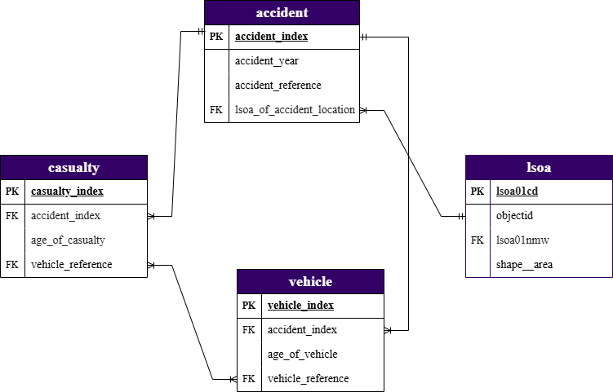
ENTITY-RELATIONSHIP DIAGRAM (ERD)
This entity relationship diagram models the relationship that exists between four tables, namely, accident, casualty, vehicle, and lsoa.
Relationship Notation (ERD)
One-to-Many between accident and casualty
One-to-Many between accident and vehicle
Many-to-many between casualty and vehicle
Many-to-One between accident and lsoa

Slide 7
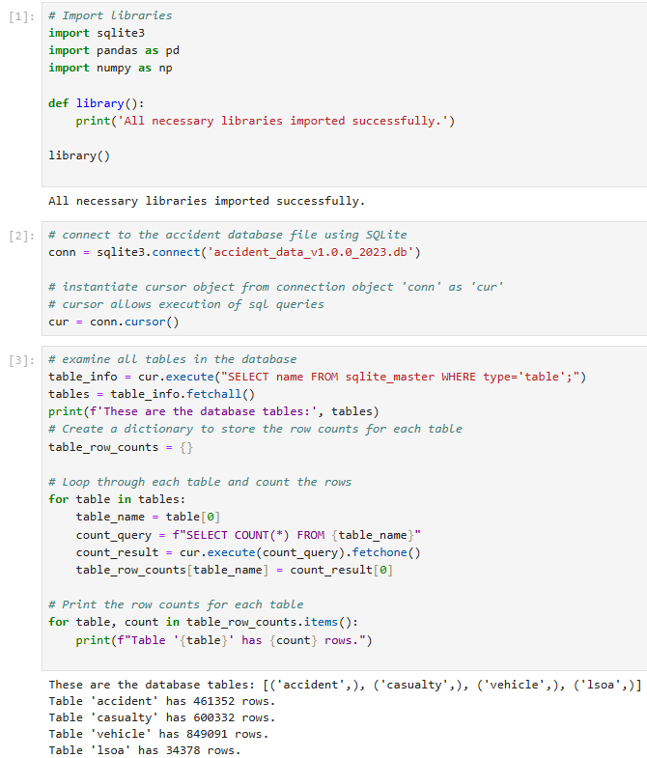
SQL COMMANDS
Setting up a jupyter notebook interactive development environment to interact with the SQLite database
Imported the necessary libraries
Established a connection to the SQLite database
Extracted the table names using SQL Master
Counted number of rows in each table.

Slide 8
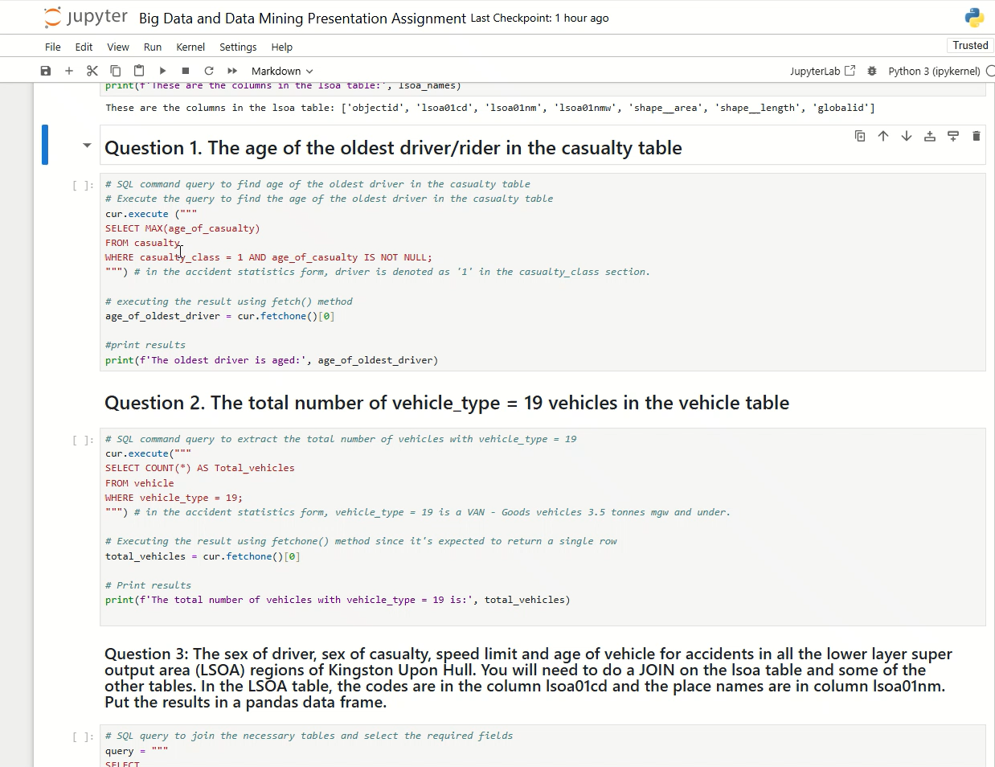
SQL COMMANDS

Slide 9
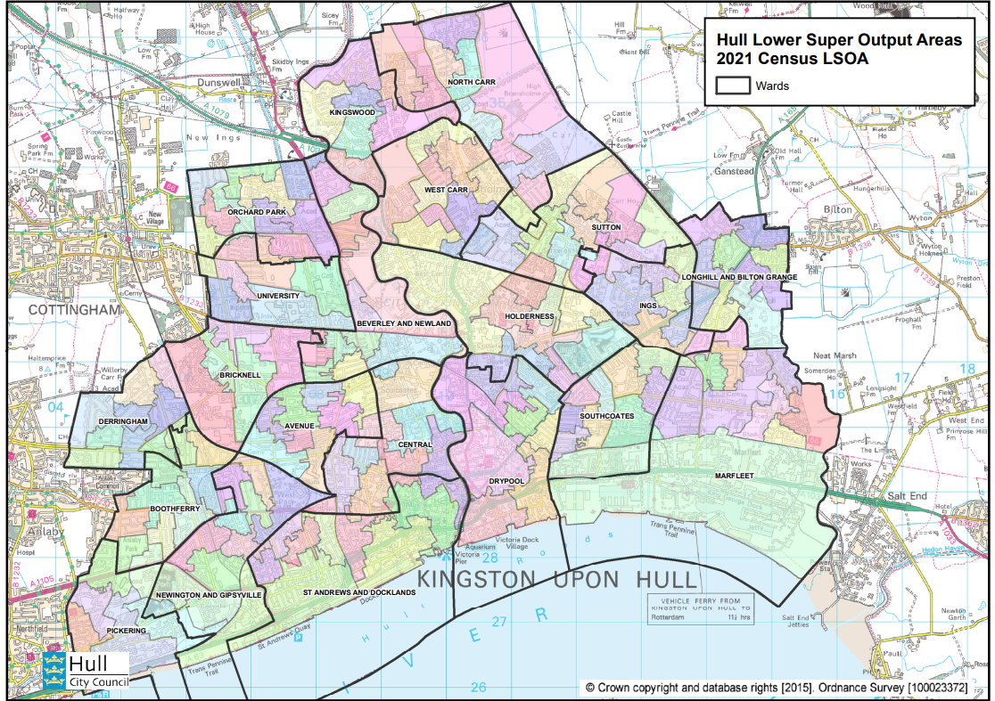
MAP OF LOWER LAYER SUPER OUPUT (LSOA) REGIONS OF KINGSTOPN UPON
I present a map of the LSOA regions of Kingston Upon Hull obtained from Hull Council to further aid our geographic understanding.
https://data.hull.gov.uk/wp-content/uploads/2021LSOA-Map.pdf

Slide 10
CONCLUSION
In this presentation, I have discussed the potential technical, ethical, and legal issues that could arise when storing accident data and explained how a SQL relational database can address these issues.
Also, I created an Entity-Relationship Diagram (ERD) to model the relationships that exists between tables in the accident database.
Furthermore, I presented a live code of analysis to extract the oldest age of the driver in the casualty column, the total number of vehicles with vehicle type = 19 and other complex queries joining all four tables to extract relevant information that can aid policy making.

